Slide 1
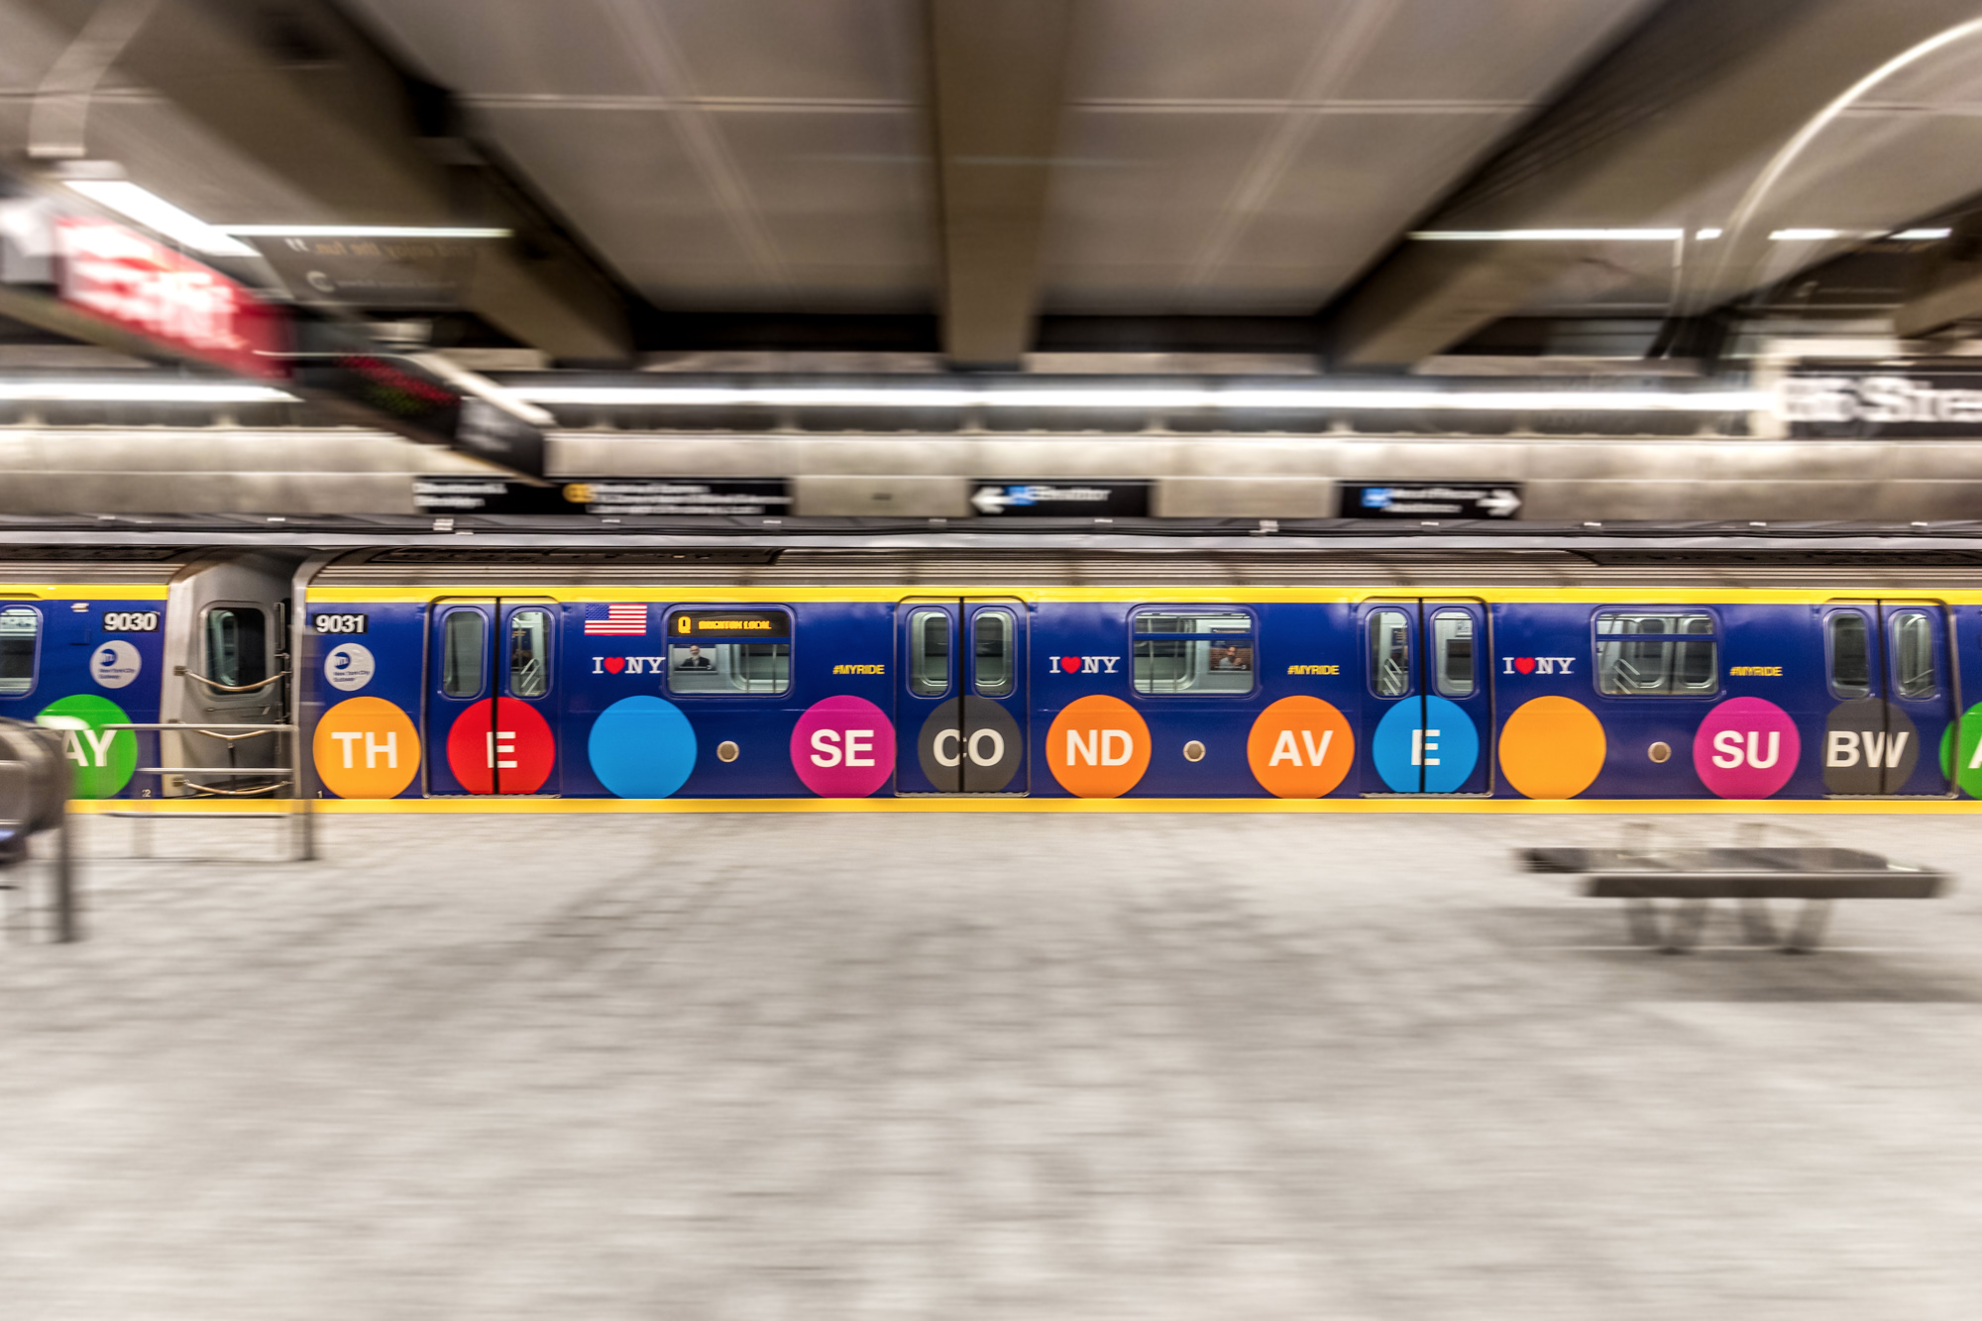
Impact of
Second Avenue Subway
Michelle Ho, Shalmali Kulkarni, Shay Lehmann,
Priyanshi Singh, Francis Ko, Akshay Penmatcha

Slide 2

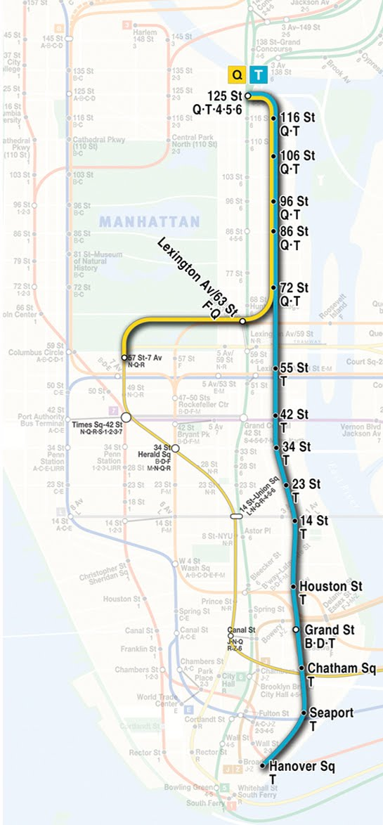
BACKGROUND
2nd Avenue Subway Line in Manhattan
Phase-1 : 3 stations on Q Line
Phase-2 : Extension of Q Line to 125th Street
Phase-3 : Start of T Line from 125th Street to Hanover Square
Phase-1 opened on January 1st, 2017
Will have a potential short-term and long term impact on the Upper East side

Slide 3
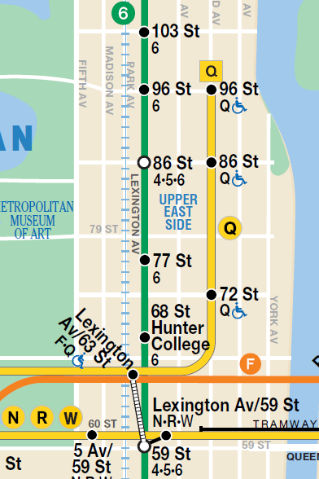
RESEARCH QUESTIONS
Short Term Impact
Are the residents of Upper East Side changing modes of transport or subway lines for their commute?
What is the overall increase in subway ridership?
Long Term Impact
How did the real estate get affected due to the subway line?
How did it impact the economic development of the area?
How does it impact the public safety of the neighborhood?

Slide 4
RESEARCH QUESTIONS
Short Term Impact
Are the residents of Upper East Side changing modes of transport or subway lines for their commute?
What is the overall increase in subway ridership?
Long Term Impact
How did the real estate get affected due to the subway line?
How did it impact the economic development of the area?
How does it impact the public safety of the neighborhood?

Slide 5
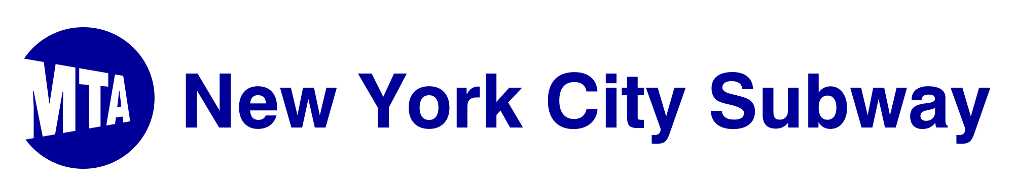





DATASETS EXPLORED
w
LODES Data
NYC Community Health Survey

Slide 6
DATASETS ANALYZED
w
Notes:
These were the two priority areas that we covered in the short span of this project

Slide 7
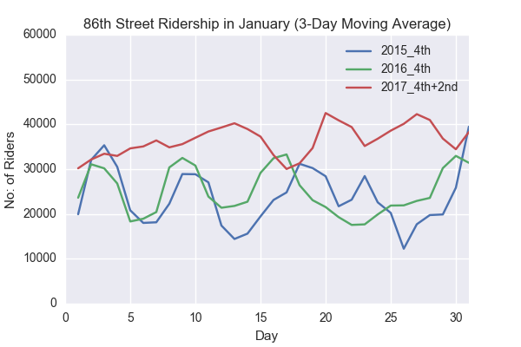
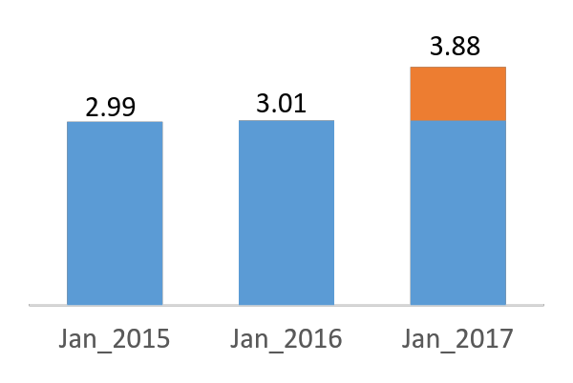
ANALYSIS
RIDERSHIP PATTERNS
January Ridership in the Upper East Side (millions)
29%

Slide 8
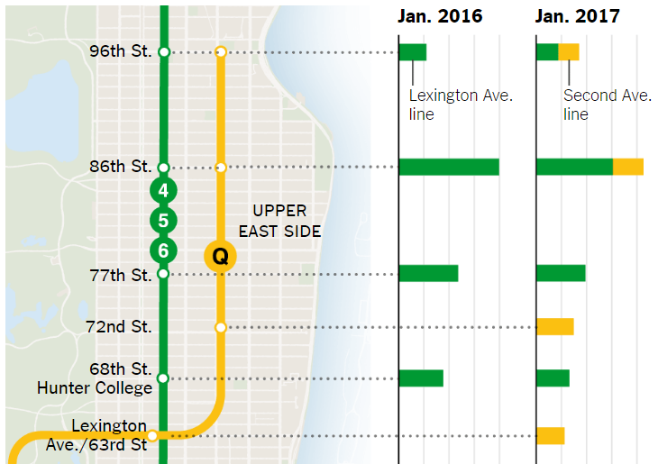
ANALYSIS
RIDERSHIP PATTERNS
41k
55k
30k
24% fewer rides on Lexington Avenue
45% decline in peak time ridership on Lexington Avenue
72nd Street has the highest daily ridership on 2nd Avenue Line
132k
94k
46k
74k
60k
51k
66k
45k
28k
*Image Source: New York Times
Daily Ridership (in thousands)

Slide 9
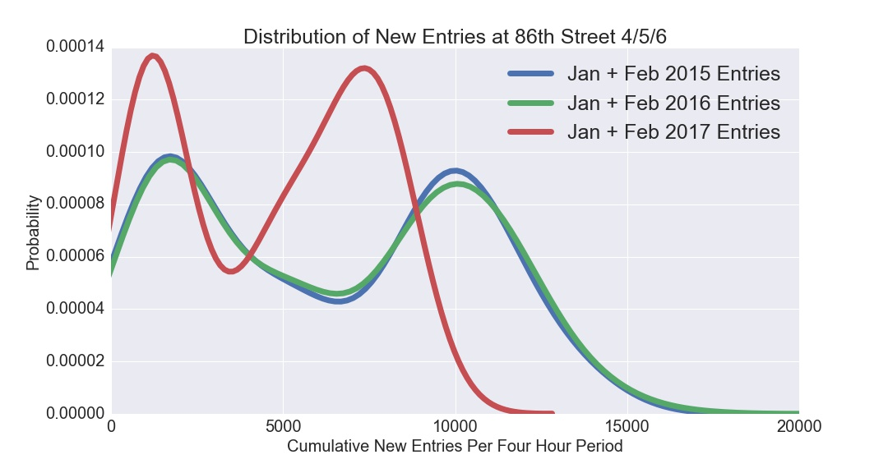
ANALYSIS
STATISTICAL ANALYSIS
Ridership distributions in 2015 and 2016 are statistically similar, whereas 2017 shows a significant leftward shift in the distribution (fewer riders per time period)
This is statistically verified using KS-Test with a significance level of 0.01 for all stations
Notes:
the distribution of new entries per four hour window shifted leftward indicating a lower ridership for each

Slide 10
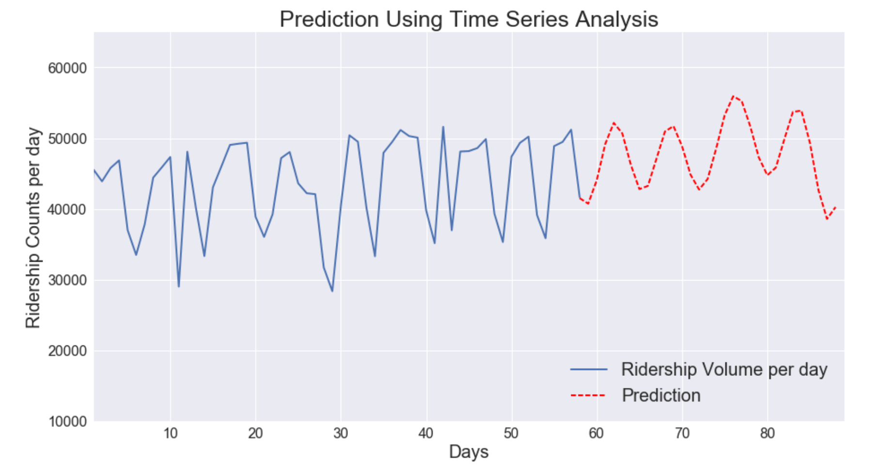
ANALYSIS
PREDICTIVE MODEL FOR RIDERSHIP VOLUMES
-500 riders in March
The slight decrease in prediction is because the training data is too small and has not yet flattened out

Slide 11
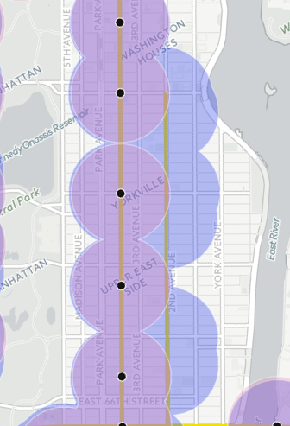
ANALYSIS
ACCESSIBILITY & COMMUTE TIME
5min walk radius around the subway stations
~65% increase in subway accessibility area in the Upper East side
MTA estimated about an 8-10min overall decrease in commute time
Analysis of Sidewalk Labs Transit explorer for travel time changes revealed a 6min decrease for certain control sample locations
https://transit.sidewalklabs.com/#{"origin":{"lat":40.72293572690569,"lng":-73.99747496850586},"options":{"bus_multiplier":1},"center":{"lat":40.75058931744187,"lng":-73.99028785458376},"zoomLevel":13,"mode":"compare-settings","options2":{"bus_multiplier":1,"exclude_stops":["Q03","Q04","Q05"]}}

Slide 12
Conclusions from Turnstile Data
An overall increase in ridership on the Upper East Side
Q line extension alleviates pressure on 4/5/6 line
Assuming:
880,000 extra riders
x $2.75 cost per ride
$ 2,420,000 in extra revenue from January alone
Costs: operating trains, station staff, regular maintenance and repair…

Slide 13
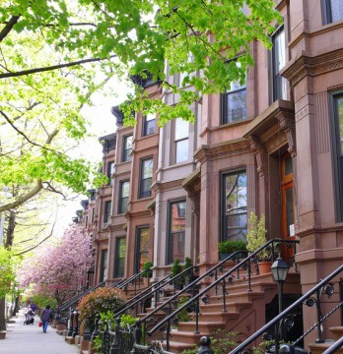
Impact of the Q extension on the neighborhood

Slide 14
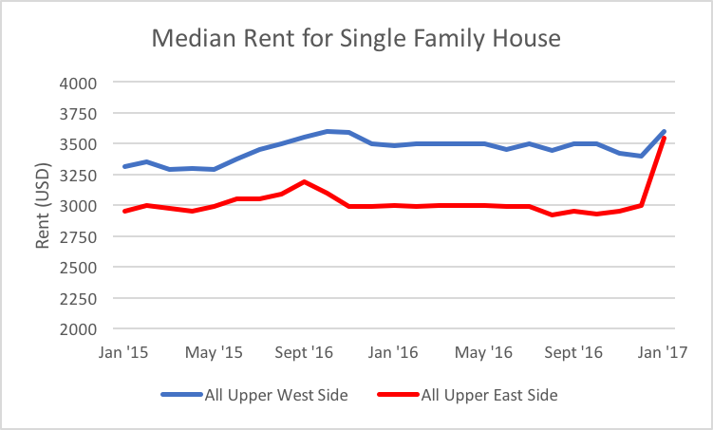
ANALYSIS
REAL ESTATE IMPACT
10% Upper West Side
18% Upper East Side
The opening of 2nd Av subway along with other factors might be contributing to this increase.

Slide 15
ANALYSIS
PREDICTION ANALYSIS
What is the impact of an additional subway station on home prices in the vicinity?

Slide 16
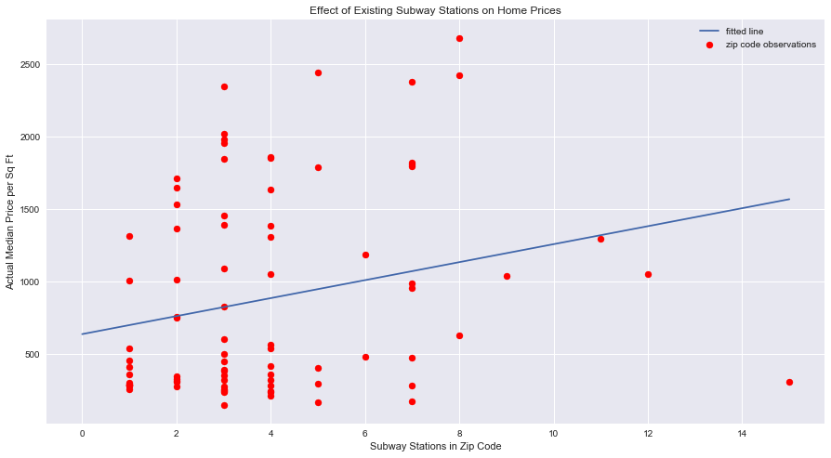
ANALYSIS
PREDICTION ANALYSIS

Slide 17
CONCLUSIONS
MTA Benefits:
Increase in overall subway ridership
Decrease in commute time for Upper East Side
Increase in accessibility to subway in the Upper east side
Alleviated pressure from the Upper East Side Lexington Avenue Line
Shift of significant riders from Lexington Ave to 2nd Avenue
Short term increase is Median monthly rent, long term prospects to be seen

Slide 18


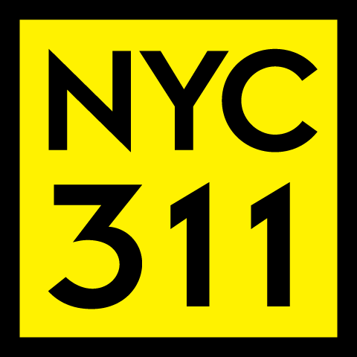
WAY FORWARD
Explore the travel mode shift from Taxi, Bus, Private car to Subway
Explore the demographic change or social impact in the long term using Census Data
Measure the impact of subway line in the change of complaint types

Slide 19
WAY FORWARD
Have people switched modes of transport? From taxi, carshare, CitiBike, private cars, buses, or walking?
Can we build a better model for home prices using distance to subway stations and population of commuters as parameters?

Slide 20
THANK YOU

Slide 21
ANALYSIS
INTERACTIVE DASHBOARD
Michelles Interactve Map

